Slide 1
Language Recognition from Audio for Pan Indian Languages
Ritika Thakur |zSaksham Singh | Sarthak Gupta | Sidhartha Garg
Group 30
ML Endsem Project
Github Repository

Slide 2
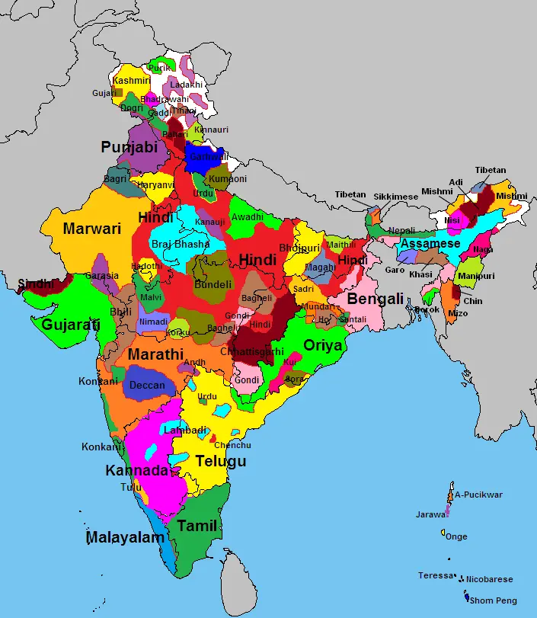

Motivation
Linguistic Diversity: India has 23 official languages and numerous dialects, creating a need for efficient language recognition systems.
Challenges in Multilingual Environments: Identifying spoken languages in India is complex due to overlapping phonetic patterns across languages.
Enhancing Communication Technologies: A reliable language recognition system can improve multilingual communication, making digital platforms more accessible for diverse users.
Notes:
India's vast linguistic diversity demands robust solutions for language recognition, especially in a multilingual environment like ours. This project seeks to bridge that gap by developing a machine learning-based system capable of accurately identifying Pan Indian languages from audio. By focusing on the unique phonetic features of each language, we aim to enhance communication technologies and make digital platforms more inclusive for India’s multilingual population, contributing to the growing field of language recognition with a focus on practical, real-world applications.

Slide 3
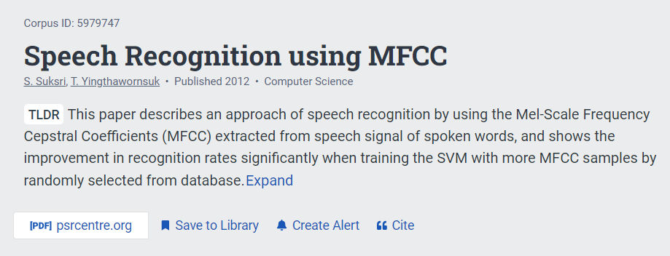
Literature review

Slide 4
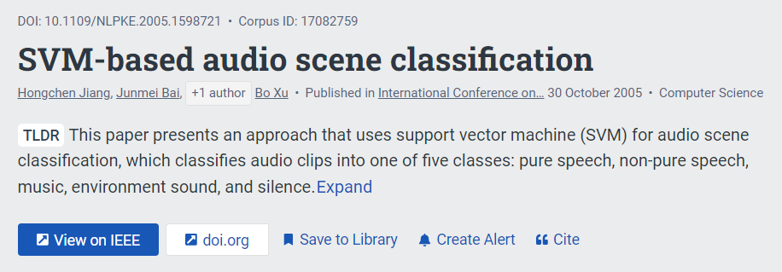
Literature review

Slide 5

Literature review

Slide 6
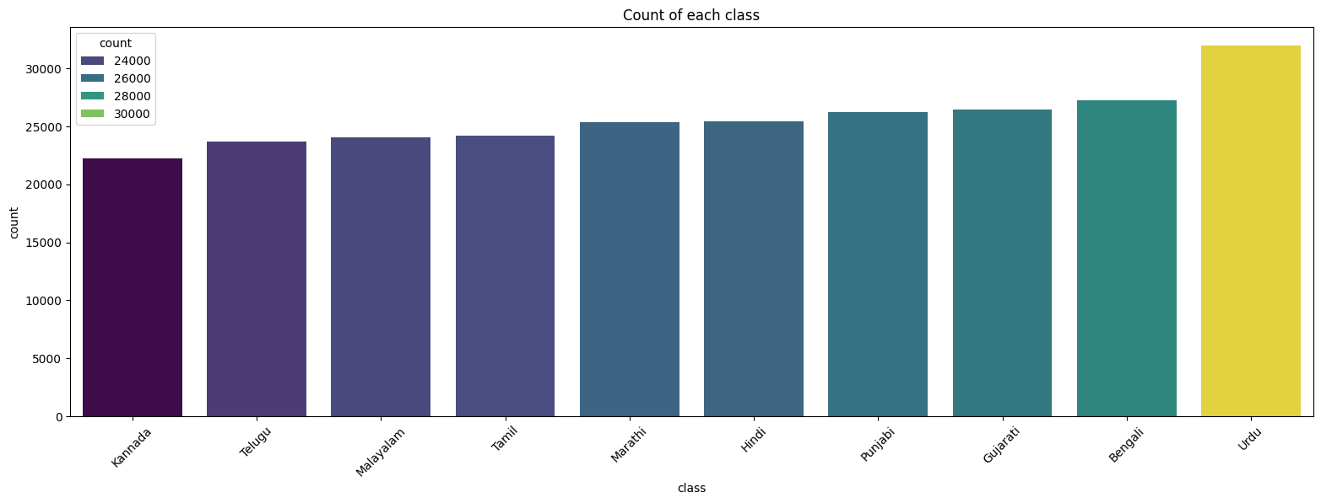

Dataset description
Sampling rate: 22050 bits/sec, 44.1 kHz Audio Length: mostly about 5 secs (outliers ~ 0 secs) Class Punjabi - Flute music - Silent files - And majorly - Gujarati audio
27k
31k
25k
25k
26k
26k
23k
24k
24k
22k
CORRUPTED HENCE DISCARDED

Slide 7
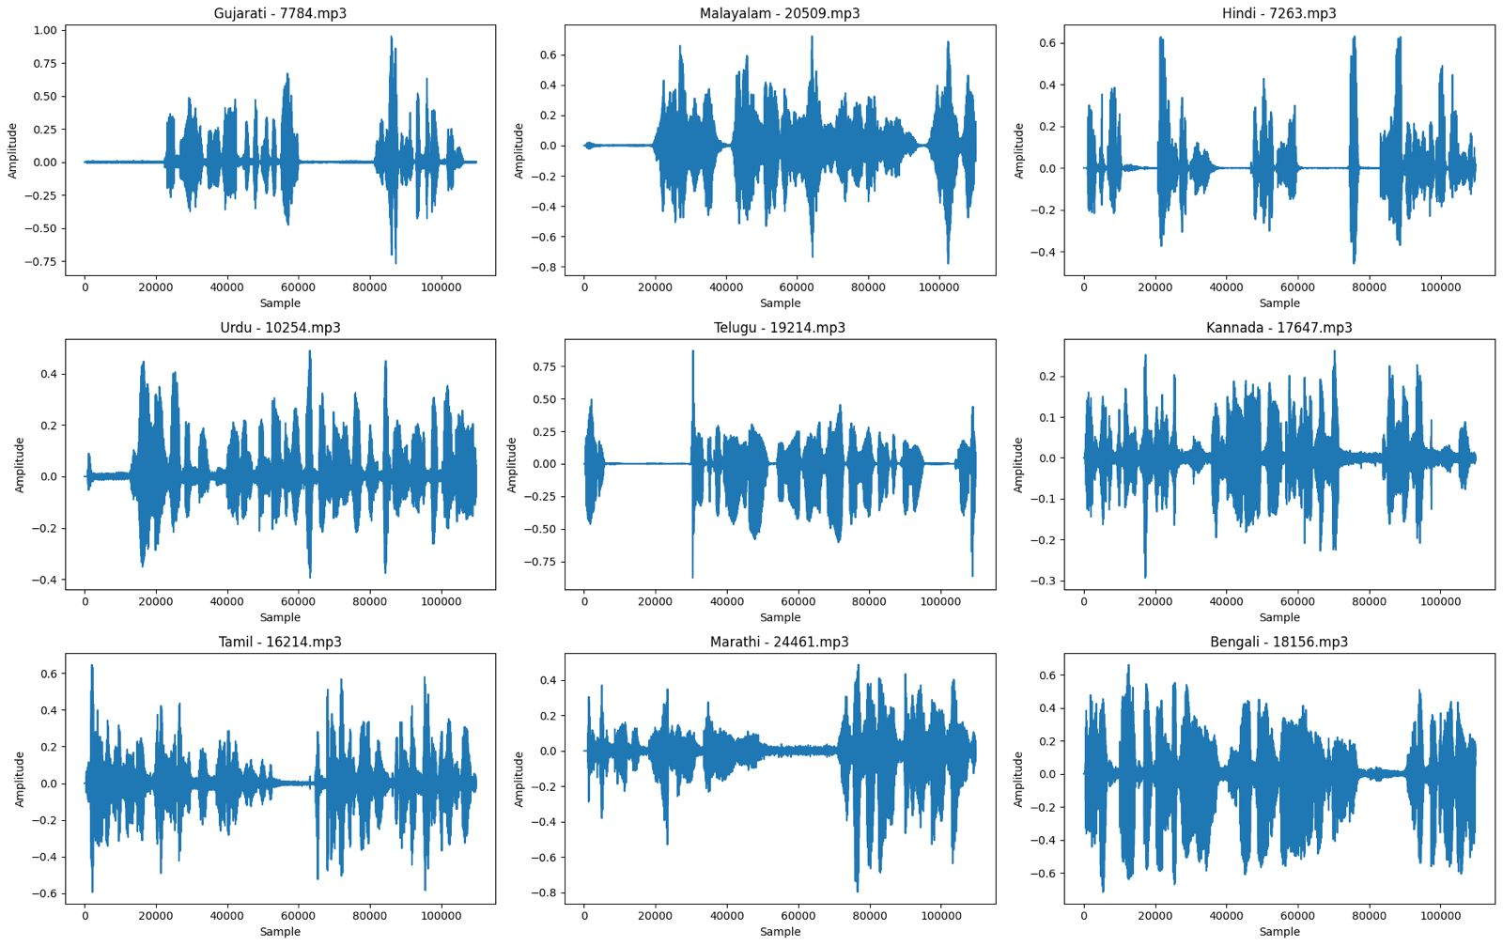
Dataset description

Slide 8
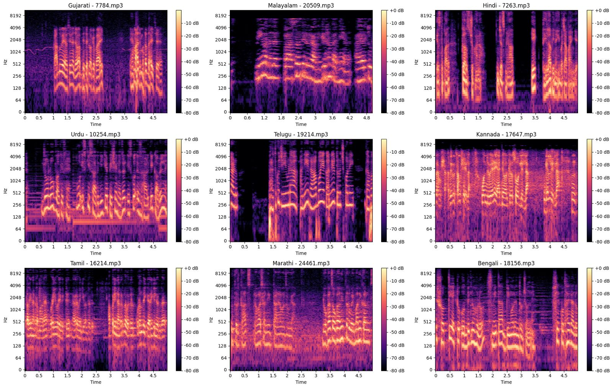
Dataset description

Slide 9

Methodology
Pre-Processing
data cleaning
feature extraction
Model selection
Parameter hyper tuning
Performance metrics

Slide 10



Methodology/Preprocessing/Data-Cleaning
Discarding of files if - length is 0 seconds - Signal-to-Noise Ratio above 0.02 (noisy)
Removal of silent segments (segments with amp < 20dB) (Completely or partially silent)
Padding of files if length < 5 seconds Trimming of files if length > 5 seconds
Audio normalization for all files

Slide 11

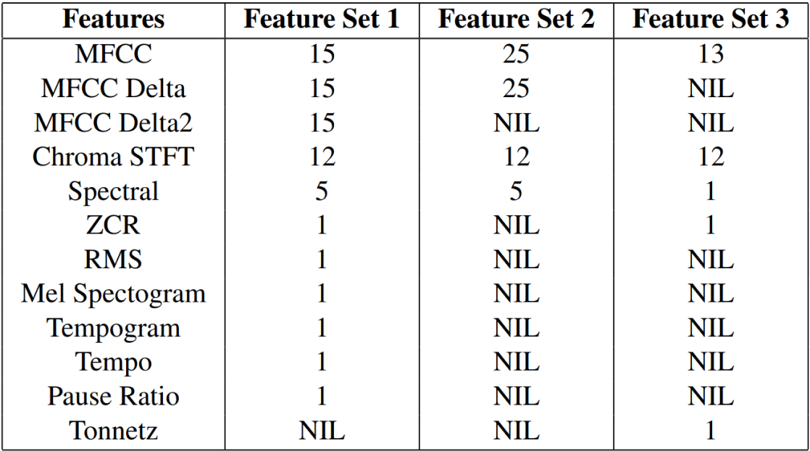
Methodology/Preprocessing/Feature-extraction

Slide 12



Methodology/Model-selection
Midsem Endsem
- Logistic Regression - Gaussian Mixture Models
- Perceptron - Hidden Markov Model
- Naive Bayes - Multilayer Perceptron
- Random Forest
- Support Vector Machine

Slide 13
Methodology/ SVM Parameters
Regularization parameter c: More c, lesser margin, chance of better accuracy but may overfit. Using grid search and k-fold cross validation, we found best c = 10 (This grid search was conducted for different kernels of SVM: linear, rbf, poly and different values of regularization parameter c: 0.1, 1, 10, 100).
Gamma: How much more the boundary is influenced by training example, i.e. how complex the boundary is.
Kernels: - Linear: for linearly separable data - Rbf: projects data to a higher dimension for nonlinear classification - Poly: uses a polynomial function for complex boundaries

Slide 14
Methodology/ GMM Parameters
Number of components (nnn): Refers to the number of Gaussian distributions (or clusters) used in the Gaussian Mixture Model. nnn = 9 (since we are working with 9 languages).
Covariance type: Specifies the type of covariance matrix used in the GMM. It can be ‘full’, ‘tied’, ‘diagonal’ or ‘spherical’. covariance type=tied (assumes a shared covariance matrix across clusters to reduce complexity).
Regularization covariance (reg_covarreg\_covarreg_covar): A small positive value added to the covariance matrix to ensure numerical stability during computation. reg covar=1e⁻³.

Slide 15
Methodology/ GMM-UBM Parameters
Extends GMM for speaker and language recognition tasks by using a Universal Background Model (UBM) to capture general patterns.
Number of components (nnn): nnn=512 (chosen to handle complex distributions).
Covariance type: covariance type=diag(improves computational efficiency).
Regularization covariance: reg covar=1e⁻⁶ (detailed modeling).
Relevance factor: 16 (balances adaptation from the UBM via MAP techniques).

Slide 16
Methodology/ HMM Parameters
Probabilistic models representing systems with hidden states that evolve over time, where each state generates observable outputs.
Number of Components (n_components): number of hidden states in the model.
Covariance Type: Specifies the structure of the covariance matrix of the Gaussian distributions: - full: Full covariance matrix (most flexible). - diag: Diagonal covariance matrix (less computationally expensive). - spherical: Shared variance across features (simplest).

Slide 17
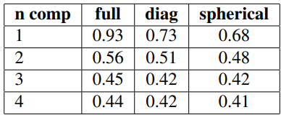
Methodology/ HMM Comparison
Probabilistic models representing systems with hidden states that evolve over time, where each state generates observable outputs.
(n_components): best accuracy with n_comp = 1. The more we increase hidden states, the more accuracy decreases.
Covariance Type: full gives the best accuracy as clearly the features are correlated. And we see a big jump from diagonal.
25 MFCC: 93.28% 67 features: 94.97%

Slide 18
Methodology/ MLP Parameters
Architecture 1: - Structure: Three hidden layers with 50, 30, and 20 neurons, respectively. - Activation Functions: Tested multiple activation functions, including ReLU, identity, tanh, and sigmoid. - Optimizer: Used the Adam optimizer for training.
Architecture 2: - Structure: Three hidden layers with 134, 268, and 134 neurons, respectively. - Dropout probability: 0.3 applied after each hidden layer to prevent overfitting. - Activation Functions: Applied ReLU activation to all hidden layers. - Optimizer: Used the Adam optimizer for training.

Slide 19
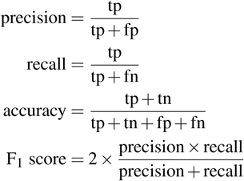
Methodology/Performance-metrics
We are generating a classification report using the scikit learn library which gives us the precision, recall, f1-score, accuracy, weighted avg and macro avg. Mean Accuracy is used as the final metric to measure the performance of each model.

Slide 20
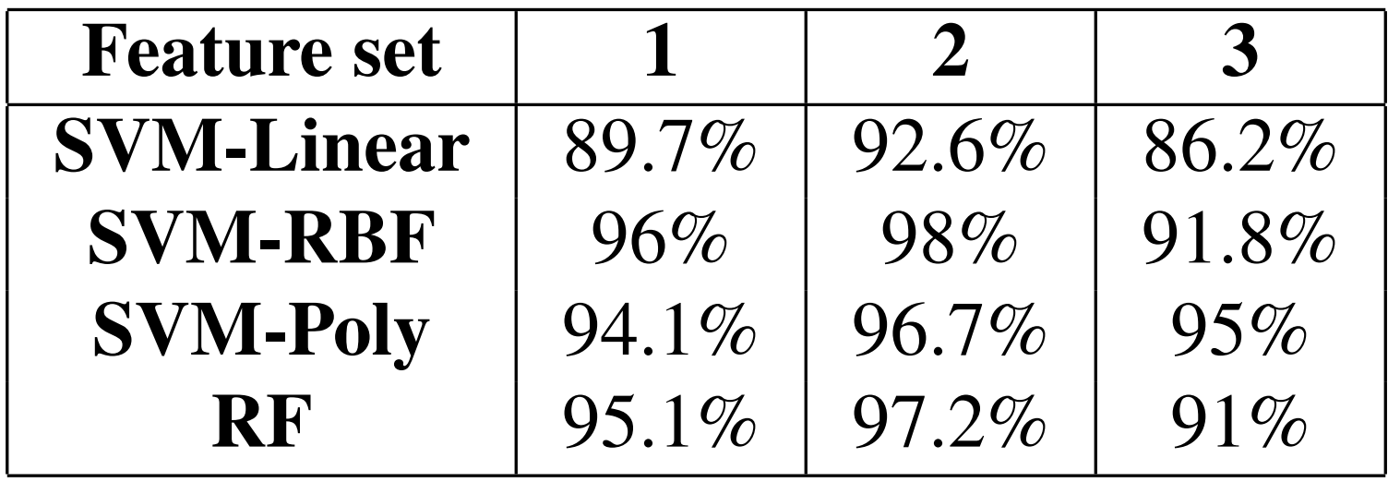
Results/Analysis/Conclusion (SVM)
C = 1
gamma = ’scale’
degree = 3
Feature Set 1 had more unique range of features as compared to Feature Set 2 which may have lead to extraction of irrelevant features, decreasing the performance.
Feature Set 2 excelled as it had more MFCC and MFCC delta coefficients as compared to the rest, further backing the paper in our literature survey.

Slide 21
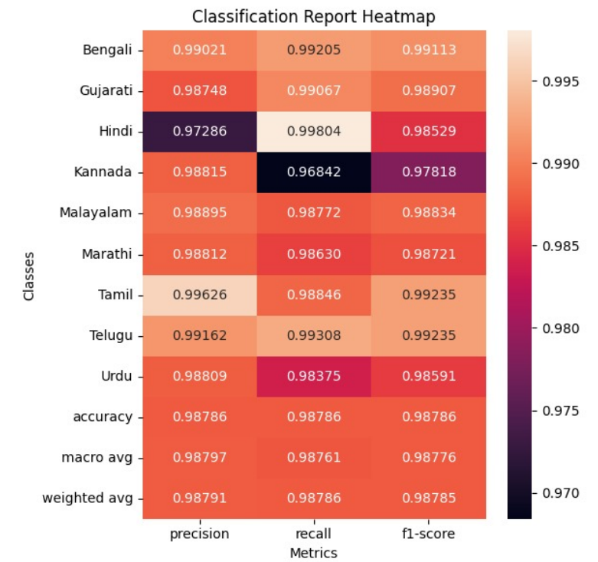
Results/Analysis/Conclusion (SVM)
The final accuracy reported for SVM-RBF for Feature Set 2 for the complete dataset is 99.03%.
On the other hand, our Random Forest classifier gives an accuracy of 98.3% with ’n estimators=100’
Random forests are still good as it is both an ensemble learning methods, and can capture non linear data.
The results of SVM-RBF show that even after robustness of RF, SVM-RBF is able to outperform it for the problem.

Slide 22
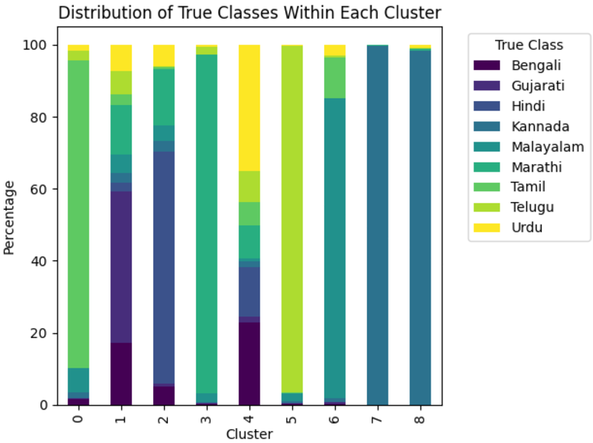
Results/Analysis/Conclusion (GMM)
Clusters 1, 6, and 7 have high purity, dominated by a single language (Hindi, Malayalam, Telugu). Clusters 3 and 4 show more overlap, indicating lower purity. This suggests GMM works well for languages with distinct features but struggles with languages that have similar characteristics.

Slide 23
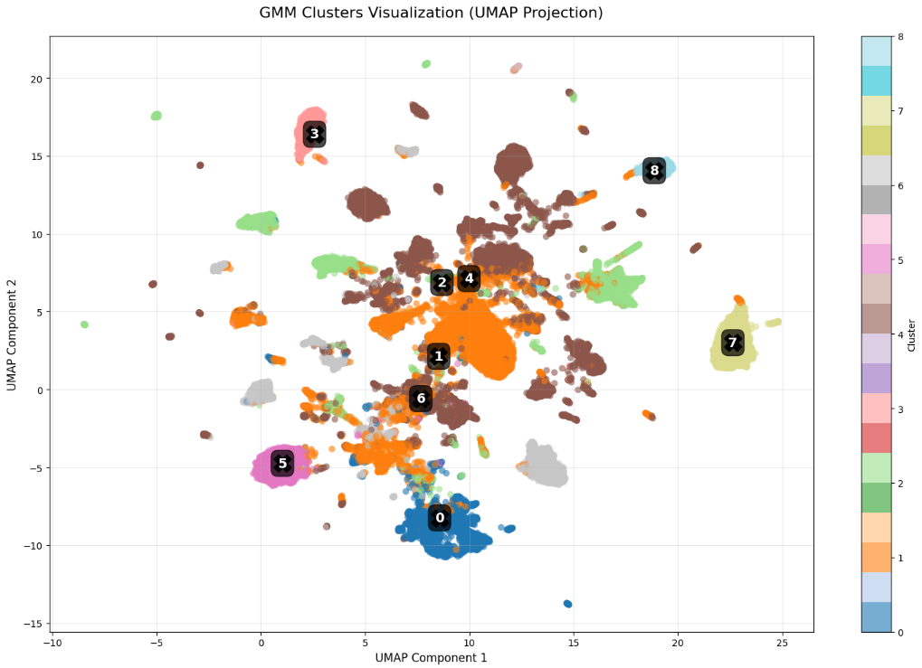
Results/Analysis/Conclusion (GMM)
Clusters 0, 1, and 7 are well-separated, matching the high purity seen in previous figure.
Clusters 2, 3, and 4 overlap, indicating poor separation, particularly for languages like Gujarati and Kannada, suggesting the need for better feature differentiation.

Slide 24
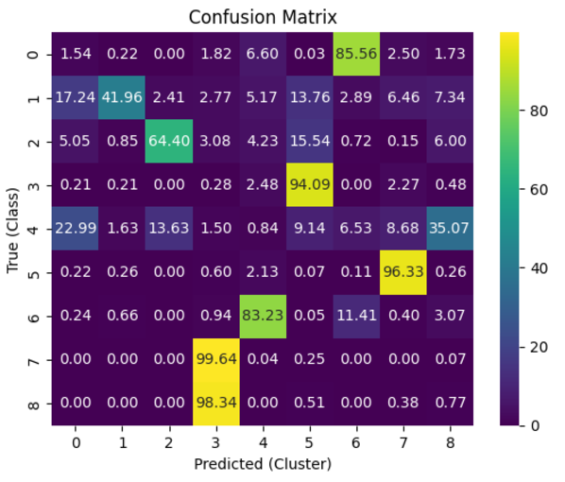
Results/Analysis/Conclusion (GMM)
The accuracy of the GMM model is 59%

Slide 25
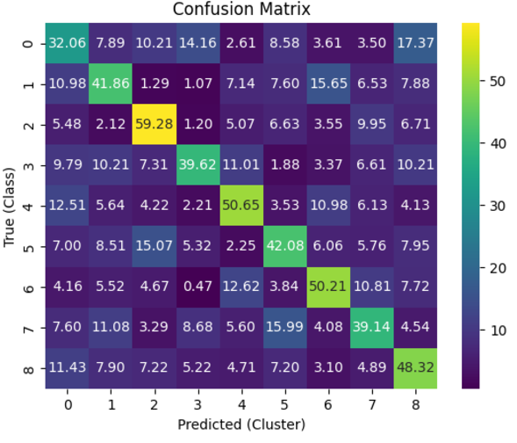
Results/Analysis/Conclusion (GMM-UBM)
The accuracy of the GMM-UBM model is 44%

Slide 26
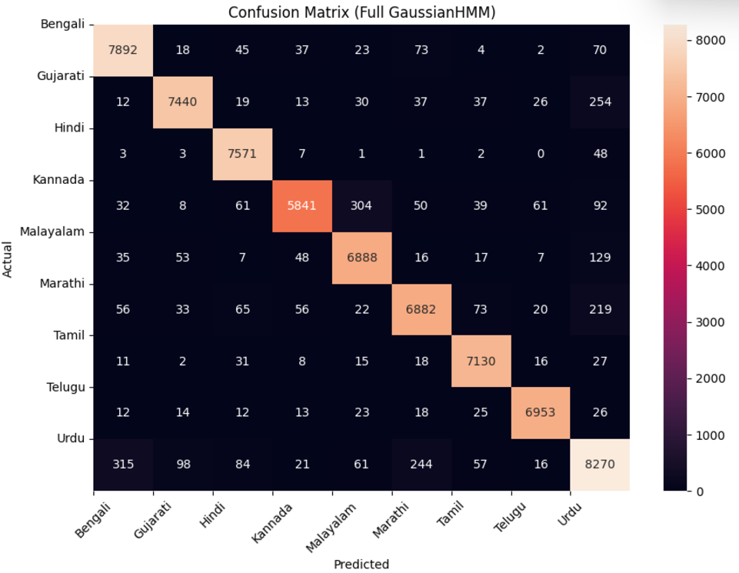
Results/Analysis/Conclusion (HMM)

Slide 27
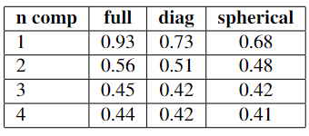
Results/Analysis/Conclusion (HMM)
The above table is for only 25 MFCC features. When taking the best parameters from above but using all 67 features we get the accuracy of 94.97%.

Slide 28
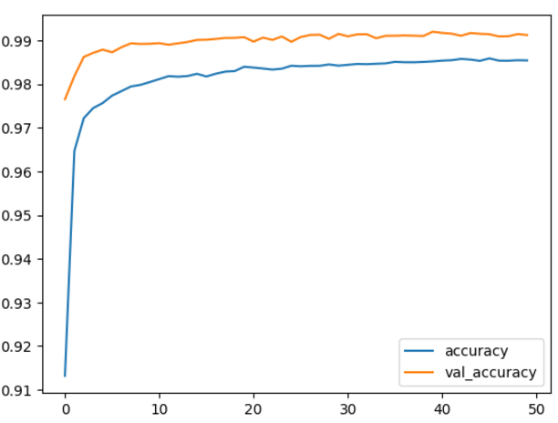
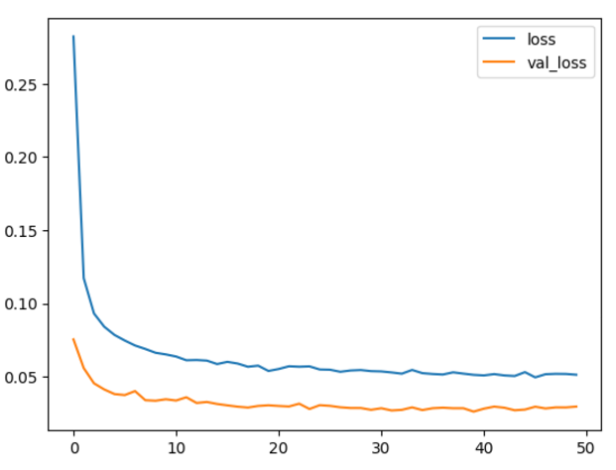
Results/Analysis/Conclusion (MLP)
Final Accuracy Achieved: 99.12%

Slide 29
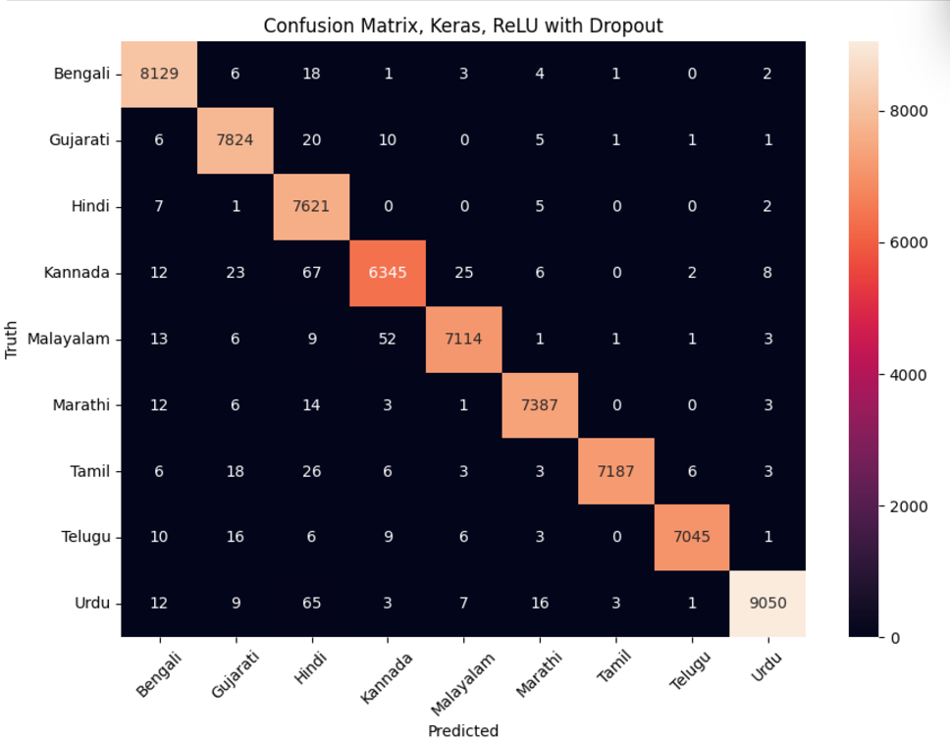
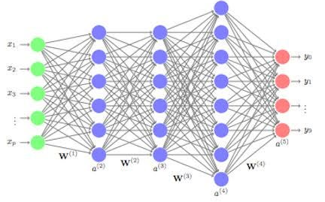
Results/Analysis/Conclusion (MLP)

Slide 30
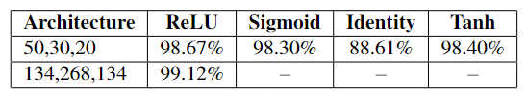
Results/Analysis/Conclusion (MLP)
The Multilayer Perceptron (MLP) with three hidden layers (134, 268, 134) and a dropout rate of 0.3 outperforms all other models, achieving an accuracy of 99.12%. This suggests that MLP is highly effective for this classification task, likely due to its ability to learn complex non-linear relationships in the data.

Slide 31
Results/Analysis/Conclusion
MLP was highly effective due to its ability to learn complex non-linear relationships in the data, enhanced by architecture structure and dropout.
GMM and HMM struggle to distinguish between languages with similar acoustic features and thus require better feature differentiation and model tuning for improved performance.
Inclusion of MFCC, spectral features, and derived features (e.g., Chroma STFT, ZCR) significantly boosted model performance.
SVM is able to effectively handle high-dimensional data, acting as a strong benchmark.

Slide 32
Timeline (Midsem)
Problem Statement and dataset selection
Ideation
Pre-Processing
data cleaning
feature extraction
Model selection
Parameter hyper tuning
Performance metrics
27th August 2024
15th September 2024
18th September 2024
28th September 2024
12th October 2024
18th October 2024

Slide 33
Timeline (Endsem)
Explore Gaussian Mixture Models, Hidden Markov Models and SVM with Universal Background Models
Explore Multi-Layer Perceptron Models
Deploy end-to-end pipeline
1st November 2024
20th November 2024
If Time Permits

Slide 34
Individual team members’ contributions
Ritika Thakur - Pre-processing, Feature Selection (Feature Set 2), Model Training (RF, Linear SVM, SVM-RBF), Report, GMM-UBM, PPT
Saksham Singh - re-processing, Feature Selection (Feature Set 1), Model Training (RF, Linear SVM, SVM-RBF, SVM-Poly), Grid Search, MLP, Report,
PPT
Sarthak Gupta - re-processing, Feature Selection (Feature Set 3), Model Training (RF, Linear SVM, SVM-RBF, SVM-Poly), HMM, PPT
Sidhartha Garg - re-processing, Feature Selection (Feature Set 1), Model Training (Linear SVM, SVM-RBF, SVM-Poly), GMM, Grid Search, Report, PPT

Slide 35

Thank You

